Slide 1
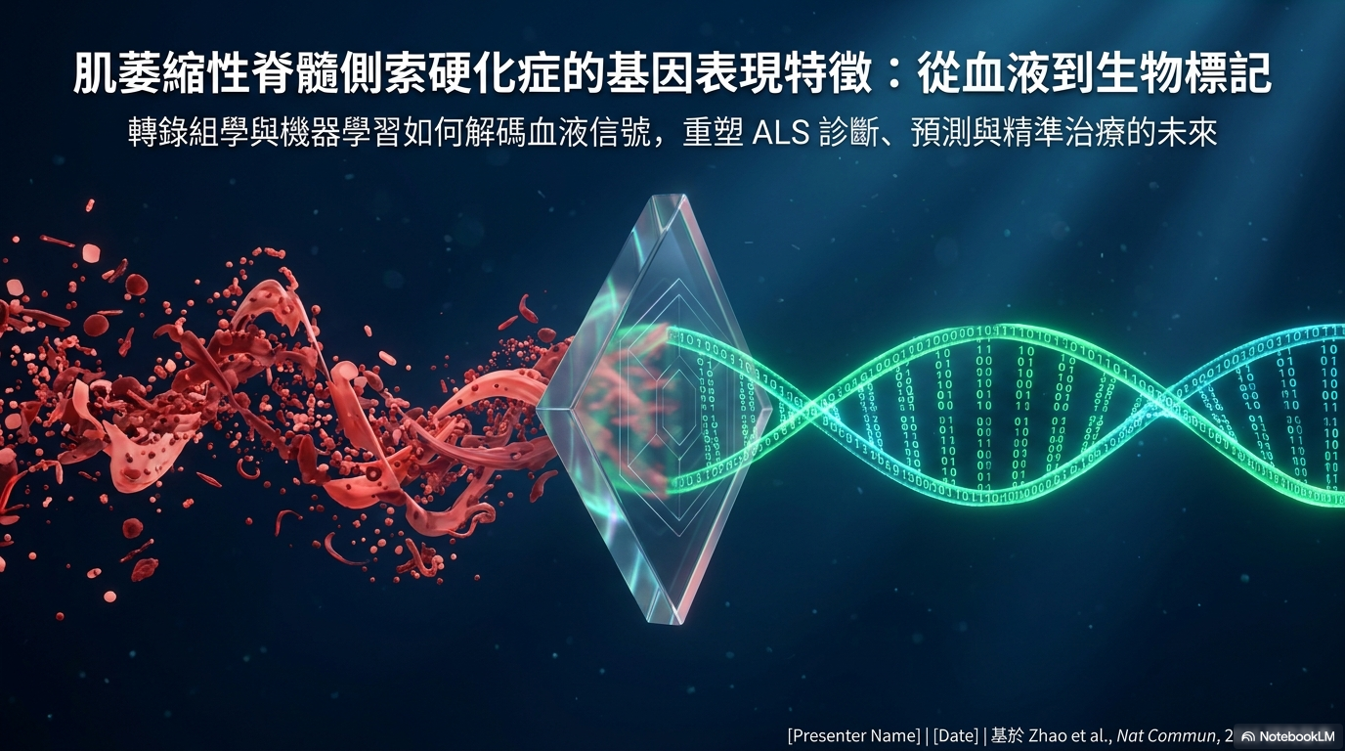
[NotebookLM 原始匯出已移除]
本投影片原為 NotebookLM 自動生成的截圖，
依版權政策需經人工編修後才可公開發布。
請以 Finch Science 重繪的教育性投影片替換。
[NotebookLM export removed]
This slide contained an auto-generated screenshot.
Per policy, it must be human-edited before publication.
Replace with a Finch Science educational slide.

Slide 2
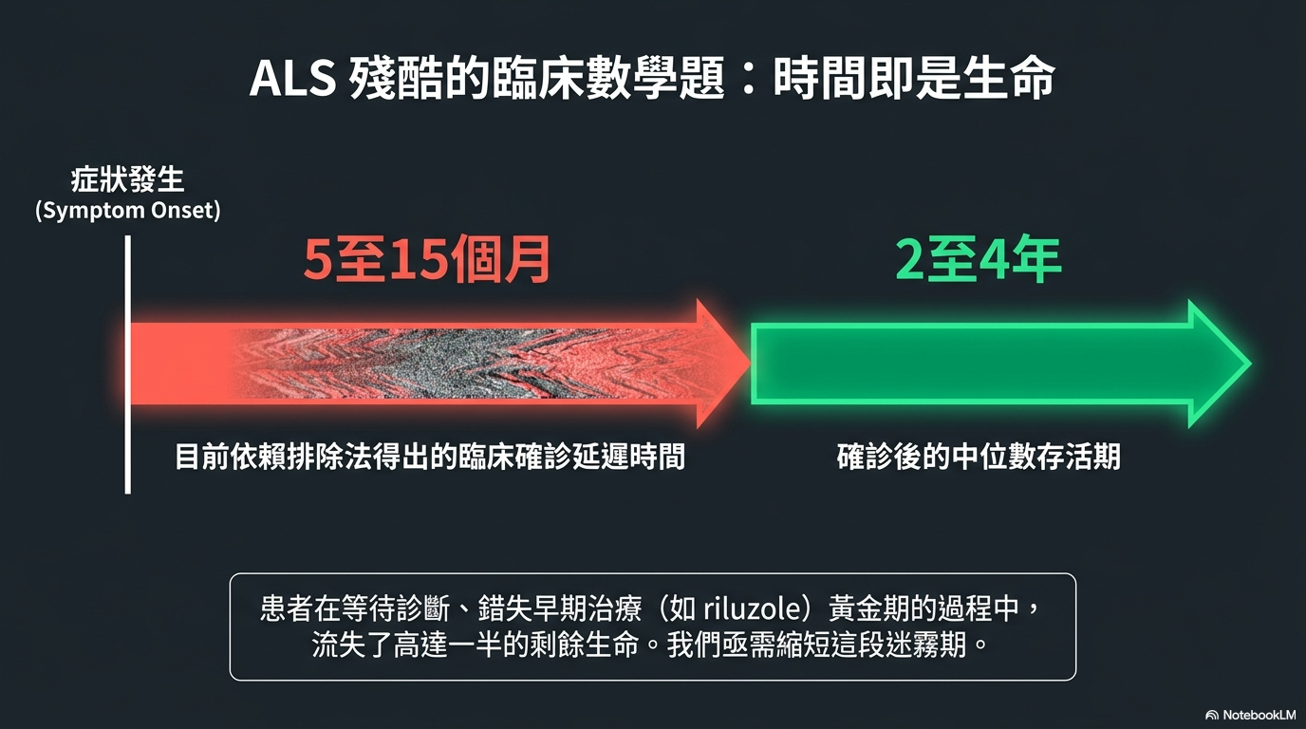
[NotebookLM 原始匯出已移除]
本投影片原為 NotebookLM 自動生成的截圖，
依版權政策需經人工編修後才可公開發布。
請以 Finch Science 重繪的教育性投影片替換。
[NotebookLM export removed]
This slide contained an auto-generated screenshot.
Per policy, it must be human-edited before publication.
Replace with a Finch Science educational slide.

Slide 3
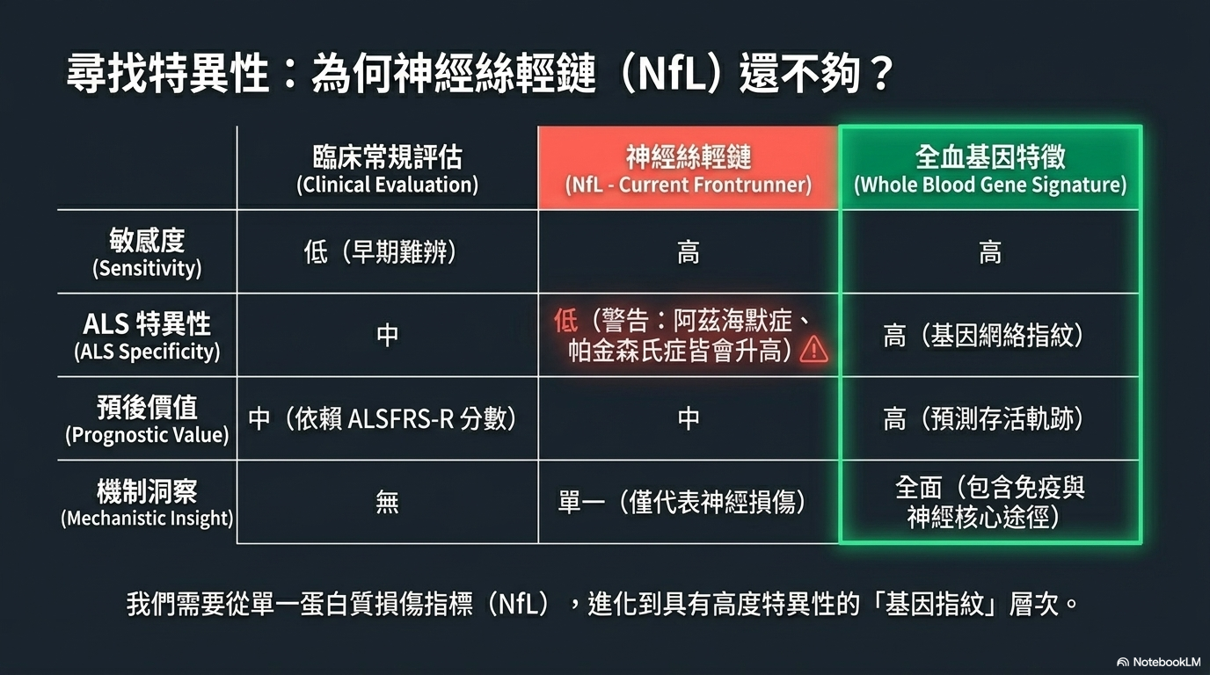
[NotebookLM 原始匯出已移除]
本投影片原為 NotebookLM 自動生成的截圖，
依版權政策需經人工編修後才可公開發布。
請以 Finch Science 重繪的教育性投影片替換。
[NotebookLM export removed]
This slide contained an auto-generated screenshot.
Per policy, it must be human-edited before publication.
Replace with a Finch Science educational slide.

Slide 4
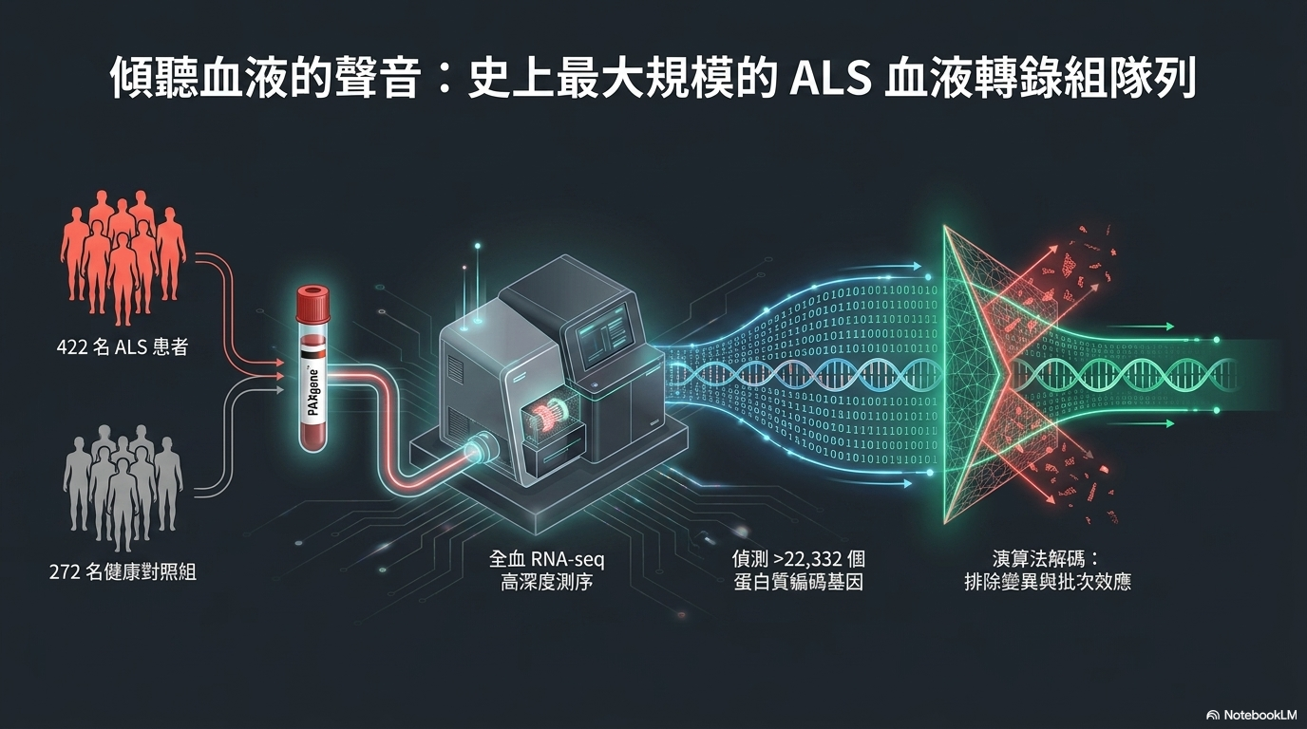
[NotebookLM 原始匯出已移除]
本投影片原為 NotebookLM 自動生成的截圖，
依版權政策需經人工編修後才可公開發布。
請以 Finch Science 重繪的教育性投影片替換。
[NotebookLM export removed]
This slide contained an auto-generated screenshot.
Per policy, it must be human-edited before publication.
Replace with a Finch Science educational slide.

Slide 5
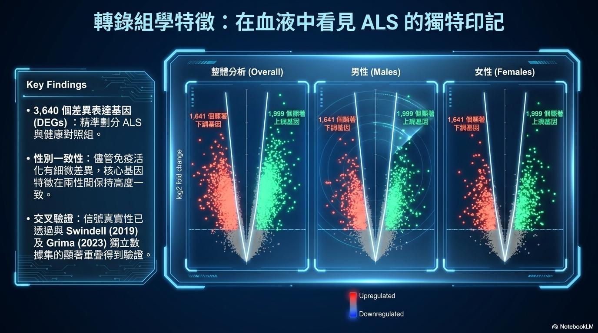
[NotebookLM 原始匯出已移除]
本投影片原為 NotebookLM 自動生成的截圖，
依版權政策需經人工編修後才可公開發布。
請以 Finch Science 重繪的教育性投影片替換。
[NotebookLM export removed]
This slide contained an auto-generated screenshot.
Per policy, it must be human-edited before publication.
Replace with a Finch Science educational slide.

Slide 6
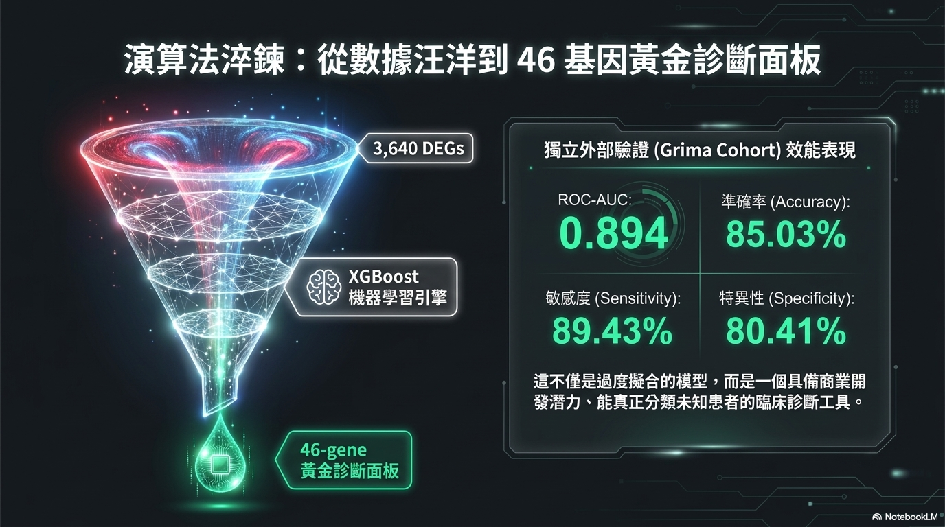
[NotebookLM 原始匯出已移除]
本投影片原為 NotebookLM 自動生成的截圖，
依版權政策需經人工編修後才可公開發布。
請以 Finch Science 重繪的教育性投影片替換。
[NotebookLM export removed]
This slide contained an auto-generated screenshot.
Per policy, it must be human-edited before publication.
Replace with a Finch Science educational slide.

Slide 7
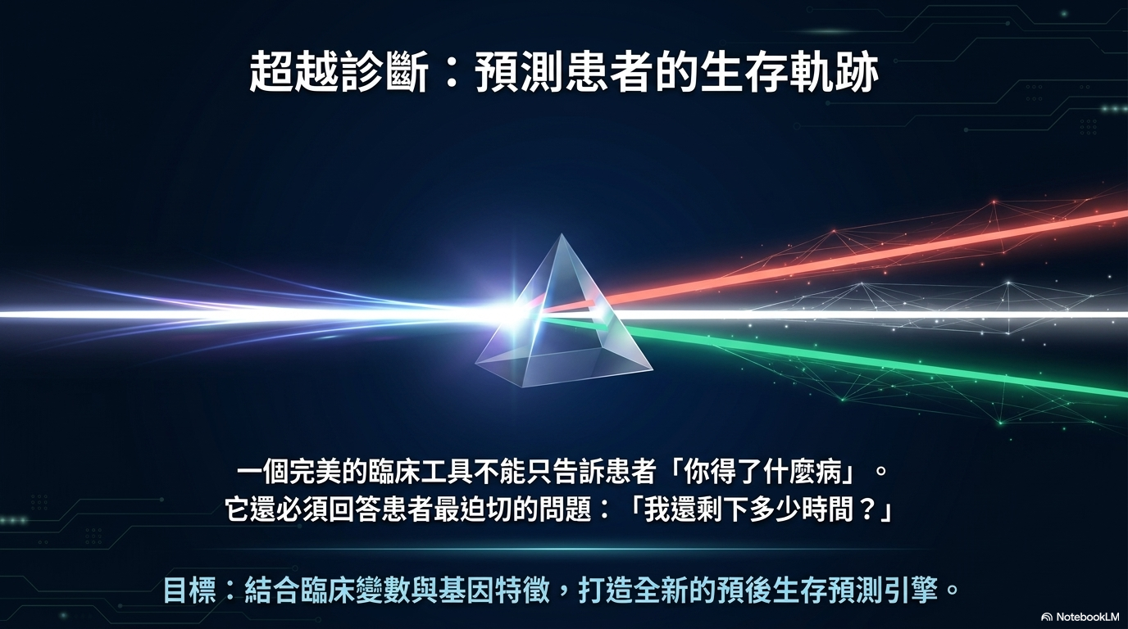
[NotebookLM 原始匯出已移除]
本投影片原為 NotebookLM 自動生成的截圖，
依版權政策需經人工編修後才可公開發布。
請以 Finch Science 重繪的教育性投影片替換。
[NotebookLM export removed]
This slide contained an auto-generated screenshot.
Per policy, it must be human-edited before publication.
Replace with a Finch Science educational slide.

Slide 8
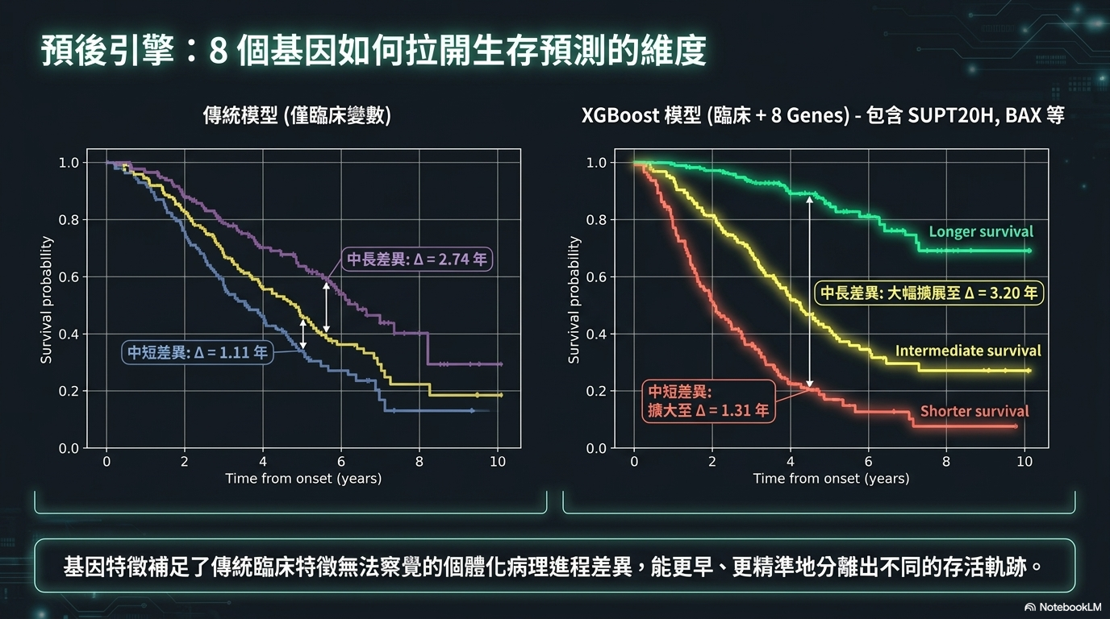
[NotebookLM 原始匯出已移除]
本投影片原為 NotebookLM 自動生成的截圖，
依版權政策需經人工編修後才可公開發布。
請以 Finch Science 重繪的教育性投影片替換。
[NotebookLM export removed]
This slide contained an auto-generated screenshot.
Per policy, it must be human-edited before publication.
Replace with a Finch Science educational slide.

Slide 9
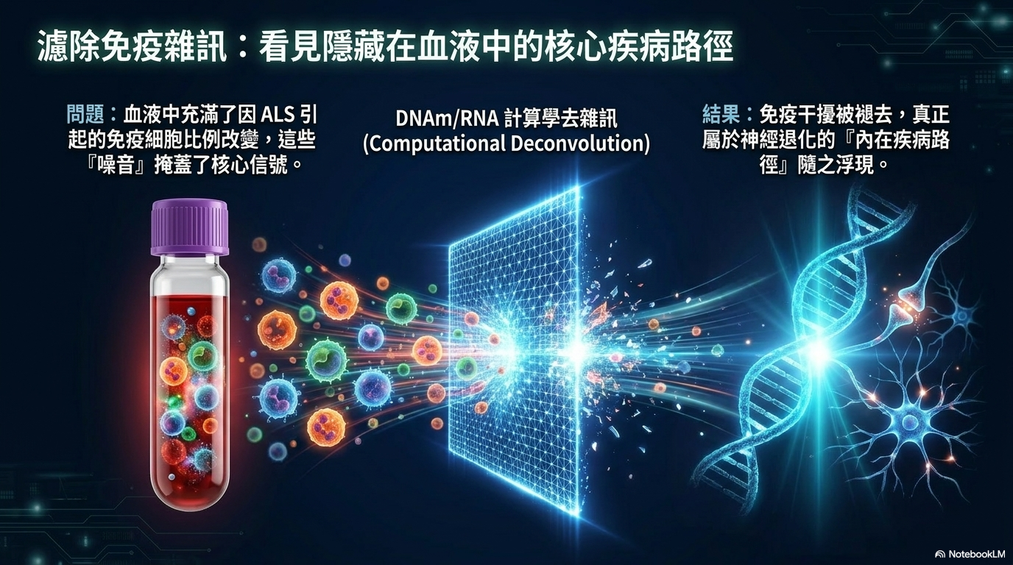
[NotebookLM 原始匯出已移除]
本投影片原為 NotebookLM 自動生成的截圖，
依版權政策需經人工編修後才可公開發布。
請以 Finch Science 重繪的教育性投影片替換。
[NotebookLM export removed]
This slide contained an auto-generated screenshot.
Per policy, it must be human-edited before publication.
Replace with a Finch Science educational slide.

Slide 10
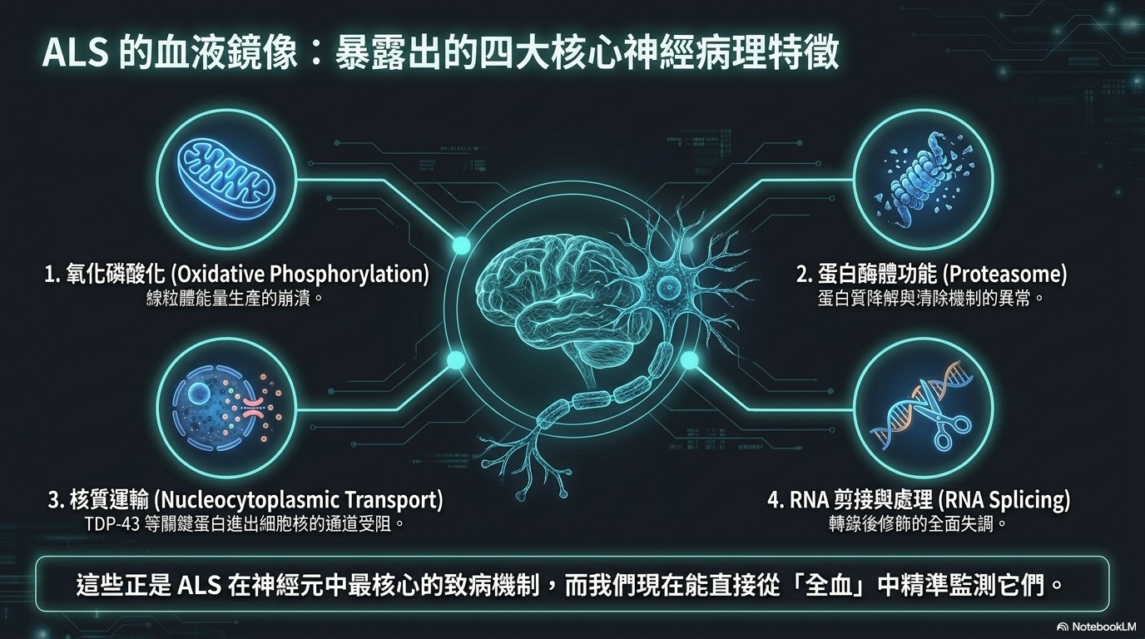
[NotebookLM 原始匯出已移除]
本投影片原為 NotebookLM 自動生成的截圖，
依版權政策需經人工編修後才可公開發布。
請以 Finch Science 重繪的教育性投影片替換。
[NotebookLM export removed]
This slide contained an auto-generated screenshot.
Per policy, it must be human-edited before publication.
Replace with a Finch Science educational slide.

Slide 11
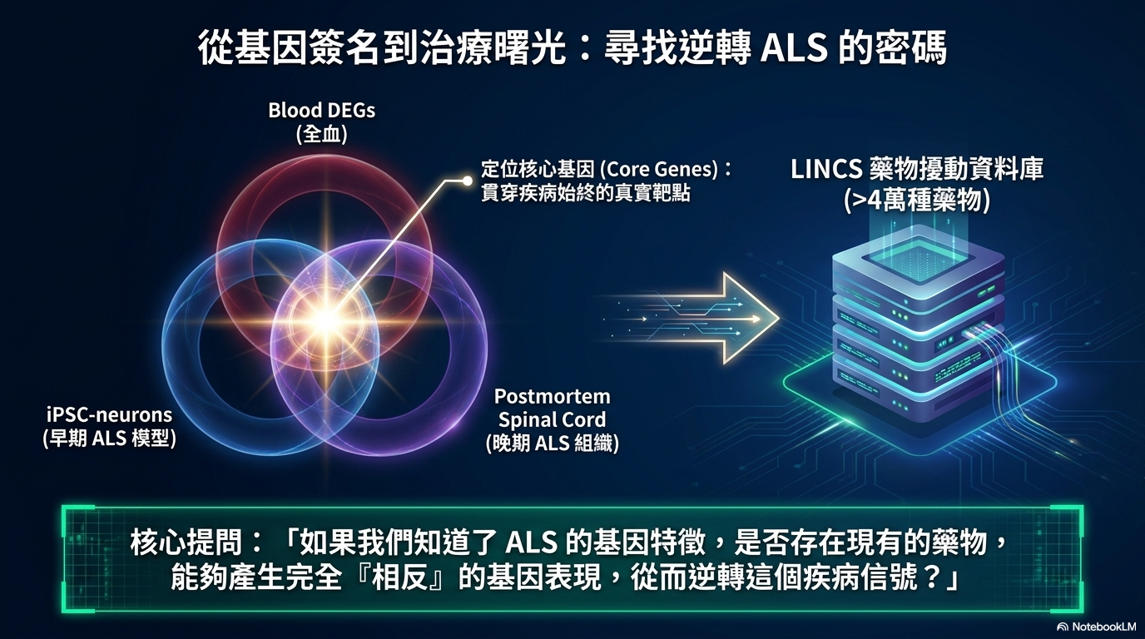
[NotebookLM 原始匯出已移除]
本投影片原為 NotebookLM 自動生成的截圖，
依版權政策需經人工編修後才可公開發布。
請以 Finch Science 重繪的教育性投影片替換。
[NotebookLM export removed]
This slide contained an auto-generated screenshot.
Per policy, it must be human-edited before publication.
Replace with a Finch Science educational slide.

Slide 12
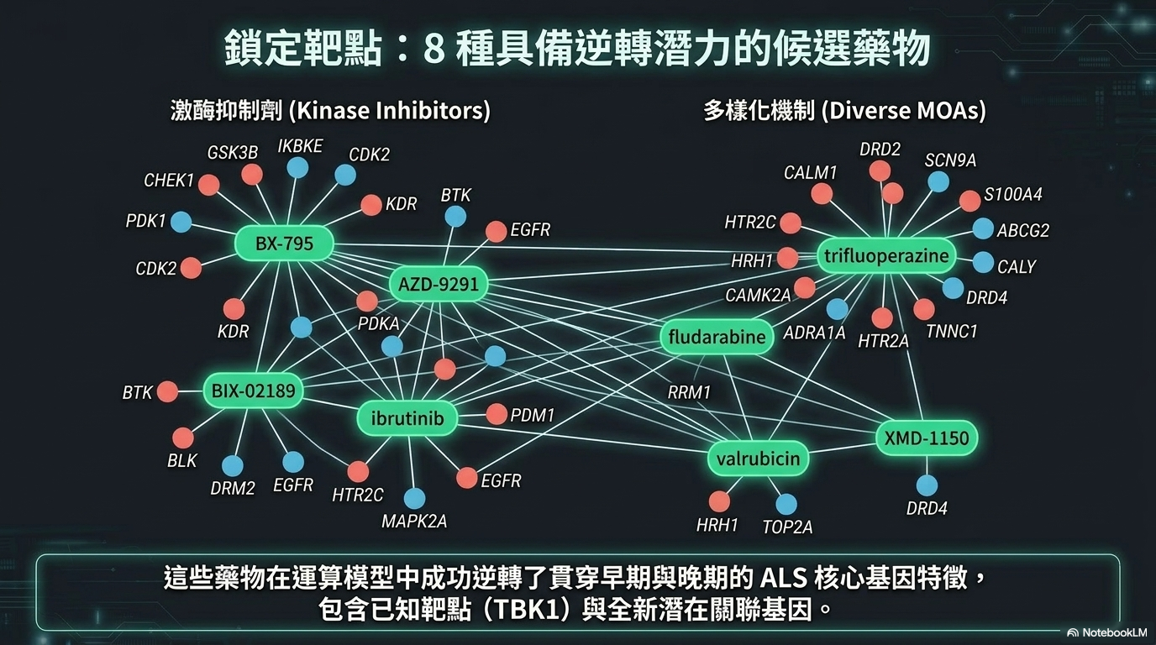
[NotebookLM 原始匯出已移除]
本投影片原為 NotebookLM 自動生成的截圖，
依版權政策需經人工編修後才可公開發布。
請以 Finch Science 重繪的教育性投影片替換。
[NotebookLM export removed]
This slide contained an auto-generated screenshot.
Per policy, it must be human-edited before publication.
Replace with a Finch Science educational slide.

Slide 13
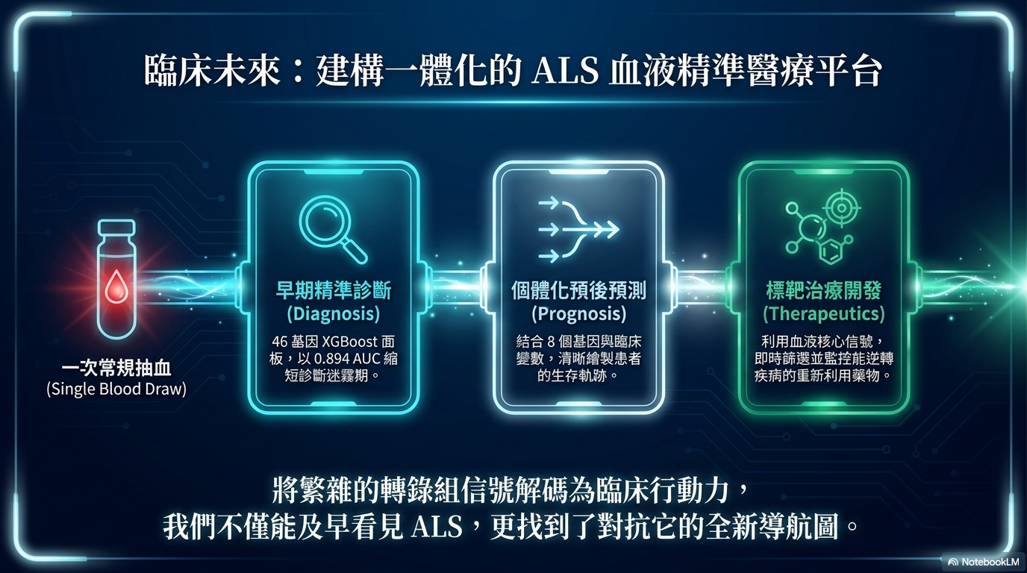
[NotebookLM 原始匯出已移除]
本投影片原為 NotebookLM 自動生成的截圖，
依版權政策需經人工編修後才可公開發布。
請以 Finch Science 重繪的教育性投影片替換。
[NotebookLM export removed]
This slide contained an auto-generated screenshot.
Per policy, it must be human-edited before publication.
Replace with a Finch Science educational slide.

